Slide 1

ECCA Payroll
MyStack Portal
Organizations use Stack+ to manage their own HR Stack. Meanwhile, employees use the self-service site MyStack to view their
own HR information.

Slide 3
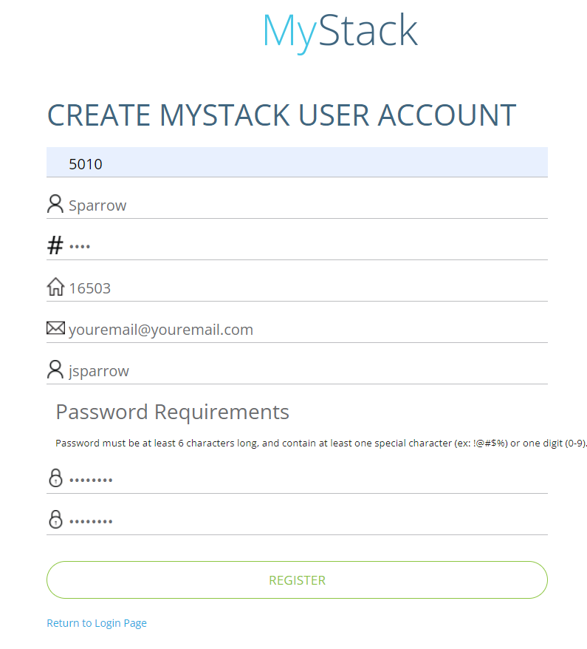
Registering an Account
In order to register for an account, you will need to get your organization’s Company Number.
Employer Code/Organization Code:
EMTA: 5010
LIFT: 5011
Go to eccapayroll.com/login/ and click MyStack.
From the MyStack login page, click Register an Account.
Complete the MyStack Form.
Enter Password.
Password must be at least 6 characters and include
at least one special character (ex:!@#$%) or one digit
Click Register.
A confirmation will be sent to the email address
you provided. This includes a link you must
click to complete your registration.
Log in in to MyStack to view your check, employee information, tax forms and timekeeping.

Slide 4
After creating an account, an email verification is sent
from MyStack to the email address that the employee
provided. The account becomes active once the
employee clicks the link contained within the account
verification email. Until they do so, they cannot log in.

Slide 5
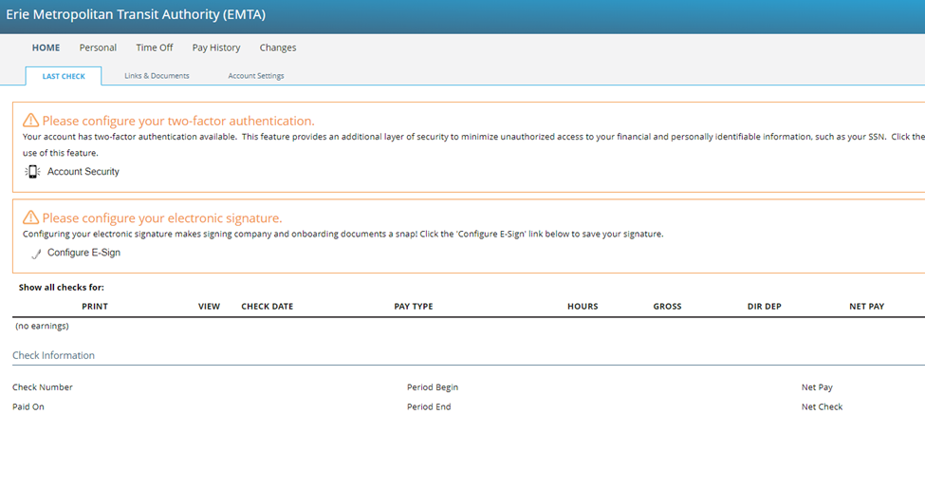

Slide 6
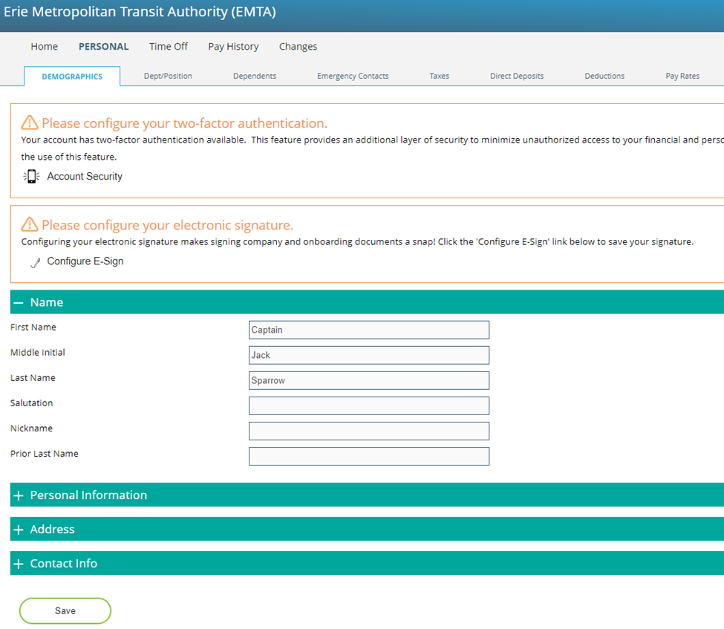
Before you can update your tax forms, you must update your account settings and Configure E-sign. System will automatically prompt you to select security method for 2 factor authentication. Configure e-sign is on the bottom right-hand side of screen. These updates must be done on a laptop, ipad, or PC (not through the mobile app).
Navigate to PERSONAL tab. Then look for Taxes under that menu tab. The screen will appear like below screen shot.

Slide 7
Please be sure to update all items found under the PERSONAL tab.
Including demographics, taxes, direct deposit and emergency contact information.

Slide 8
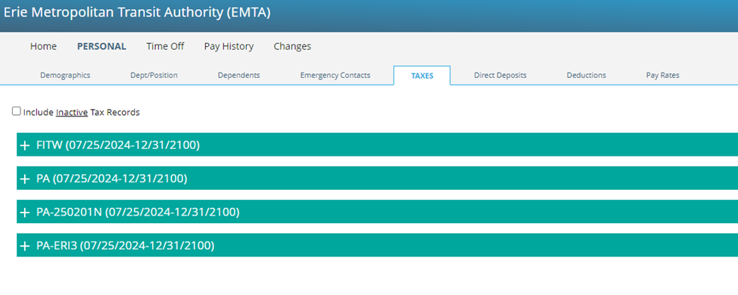
Navigate to PERSONAL tab. Then look for Taxes under that menu tab.

Slide 9
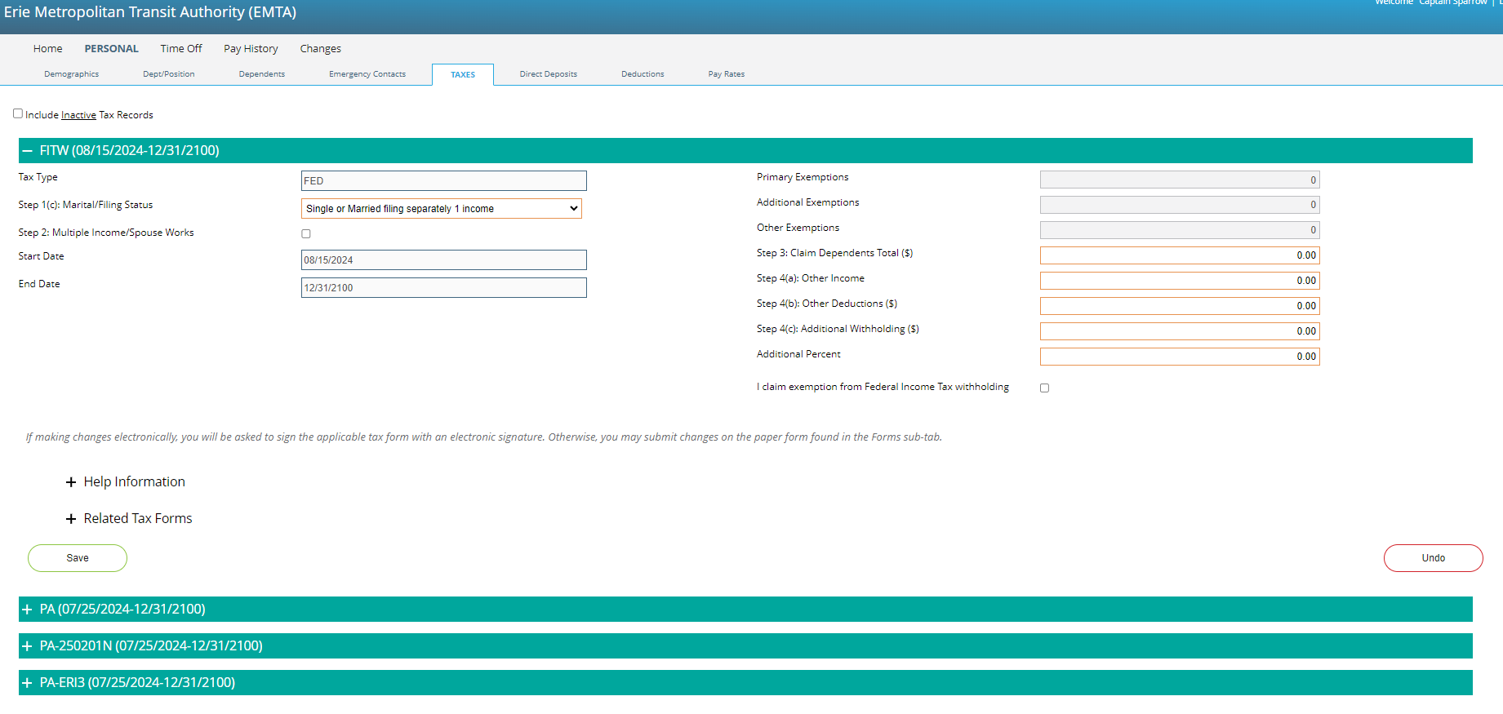
Make sure all tax information & withholdings is correct.

Slide 10
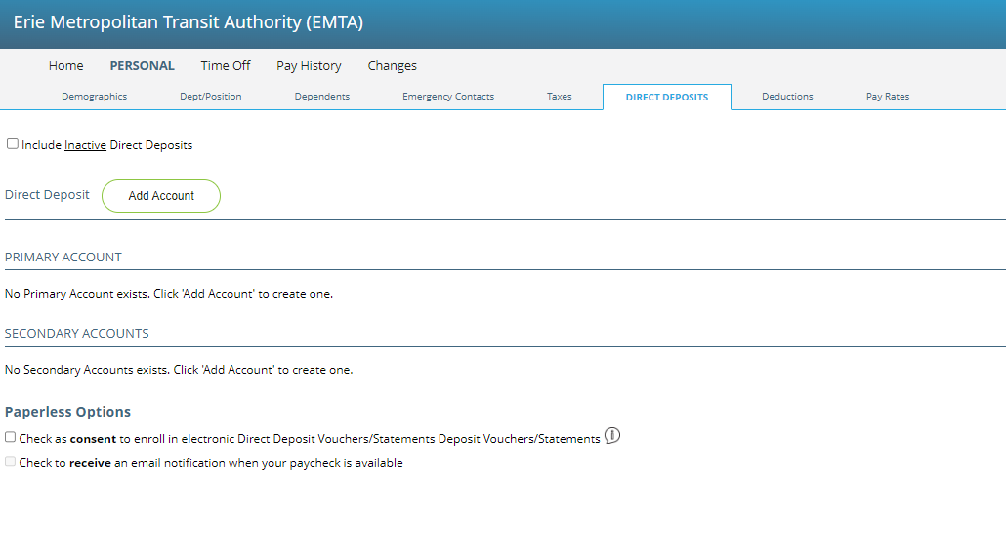
Make & submit changes on how you receive your payment under Direct Deposit.

Slide 11
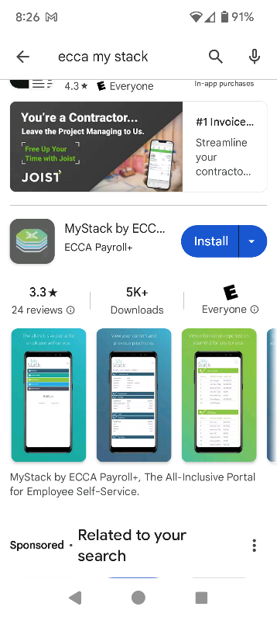
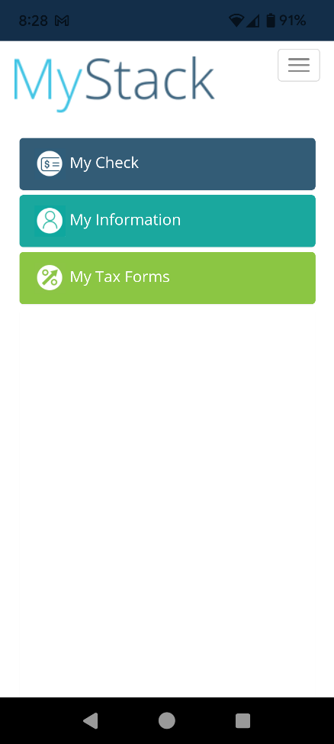
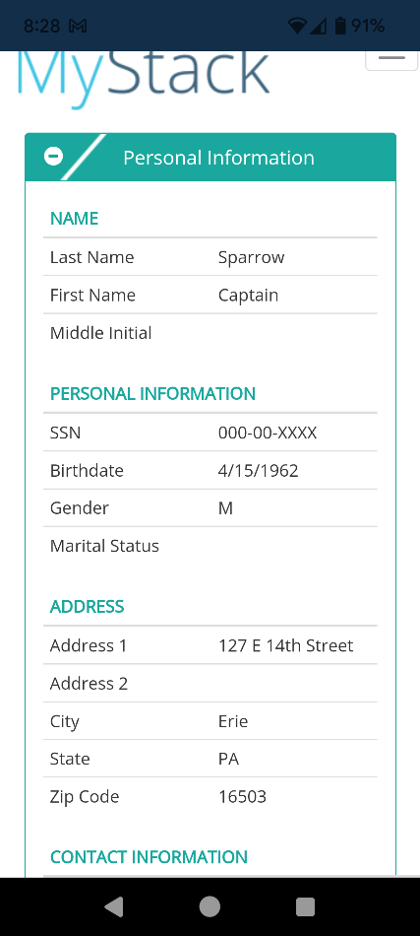
MyStack App: viewing tool – but no one can make changes on the mobile app – all changes have to be completed through the website on a PC/laptop, etc.

Slide 12

Thank you for your cooperation in transitions to ECCA and the MyStack Portal.
For technical support (log in or general IT questions), please contact Branden Montgomery at 814.454.4012 ext 130 or bmontgomery@ride-the-e.com
Thank you!
Theresa J Lugo, Director of HR Vicky Takach, Controller
814.454.4012 x 106 814.454.4012 ext 116
tlugo@ride-the-e.com vtakach@ride-the-e.com

